Slide 1
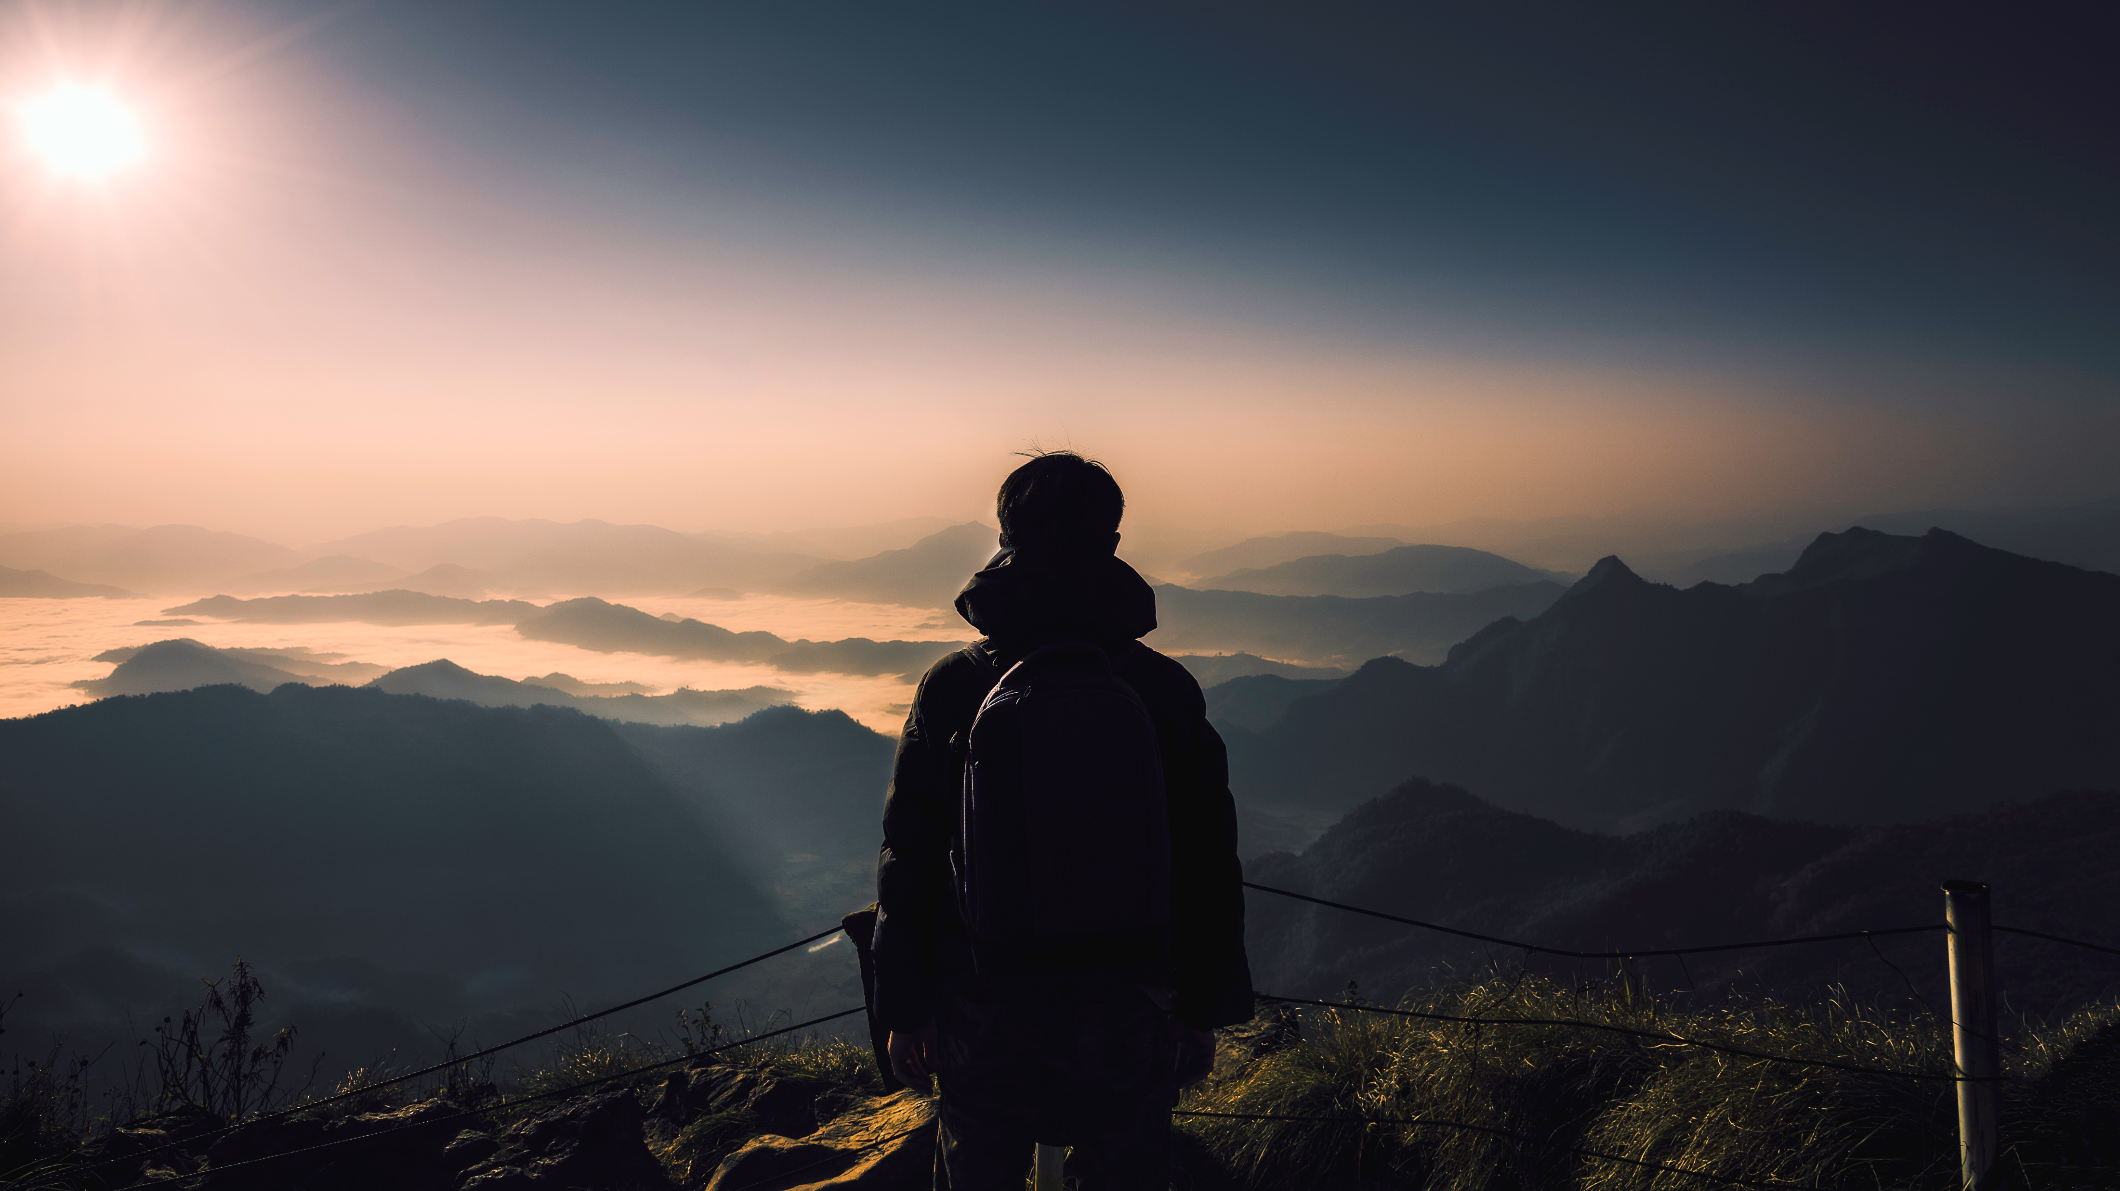
TRAVEL AI
Your Personalized Journey Unleashed

Slide 2

Problem
In today's fast-paced world, travelers often face the overwhelming task of planning their trips.
Traditional methods can be time-consuming, generic, and lack personalization.
We recognized the need for a solution that caters to individual preferences, saving time and ensuring truly memorable experiences.

Slide 3



Meet Travel AI
Travel AI is a state-of-the-art application that harnesses the power of artificial intelligence to generate personalized tours.
Our app empowers you to create a tailor-made itinerary based on your unique interests, preferences, and desired destinations.
Say goodbye to one-size-fits-all tours and embrace the freedom to design your dream journey.

Slide 4




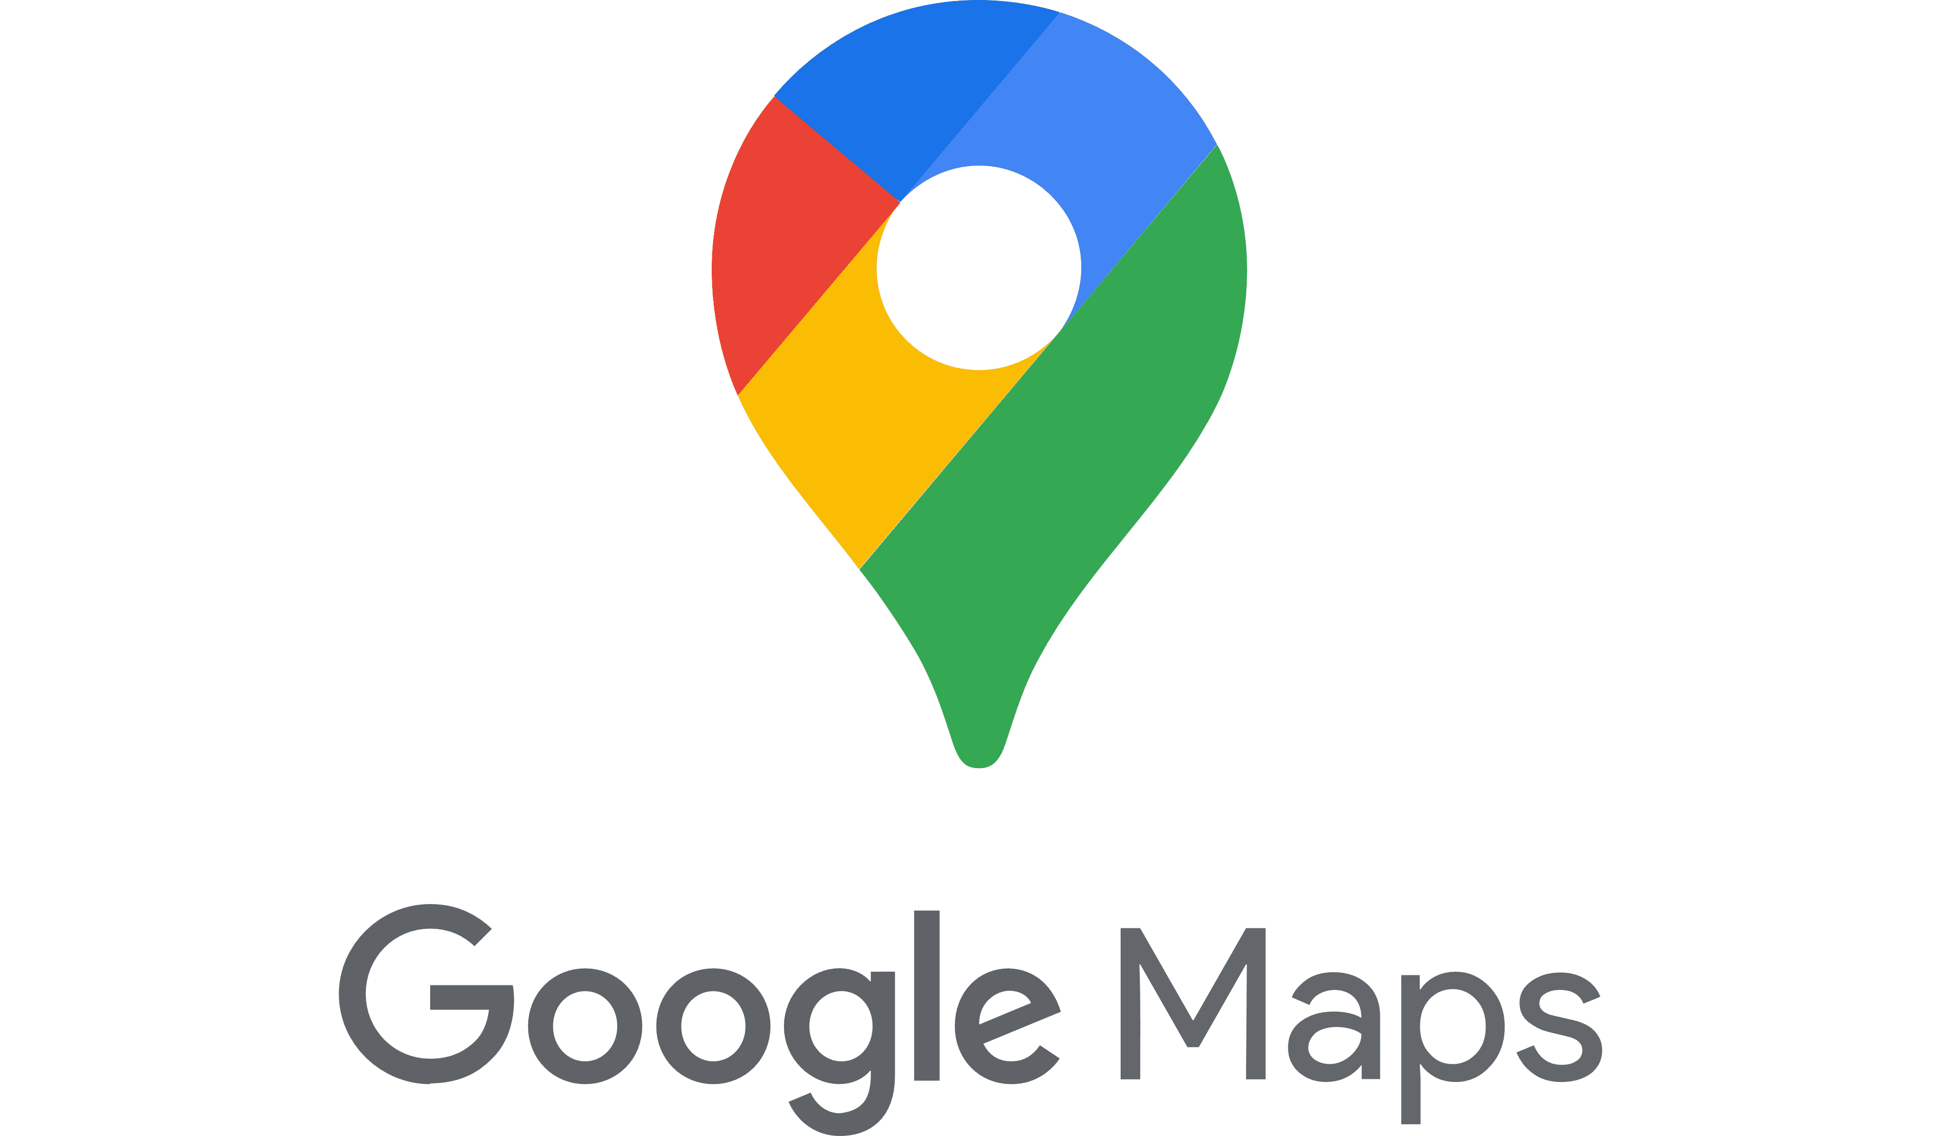
How it works
Travel AI utilizes advanced algorithms to generate a personalized itinerary based on the user's destination and journey preferences. By harnessing the powerful capabilities of Google Vertex AI, our application generates a recommended tour based on the user's location and provided preferences. Additionally, we enrich the personalized itinerary by incorporating data obtained through the Google Maps API, providing users with comprehensive information to enhance their exploration and understanding of the tour recommendations.
API
Vertex AI
React
User
Front-end
API
Python
Back-end

Slide 5
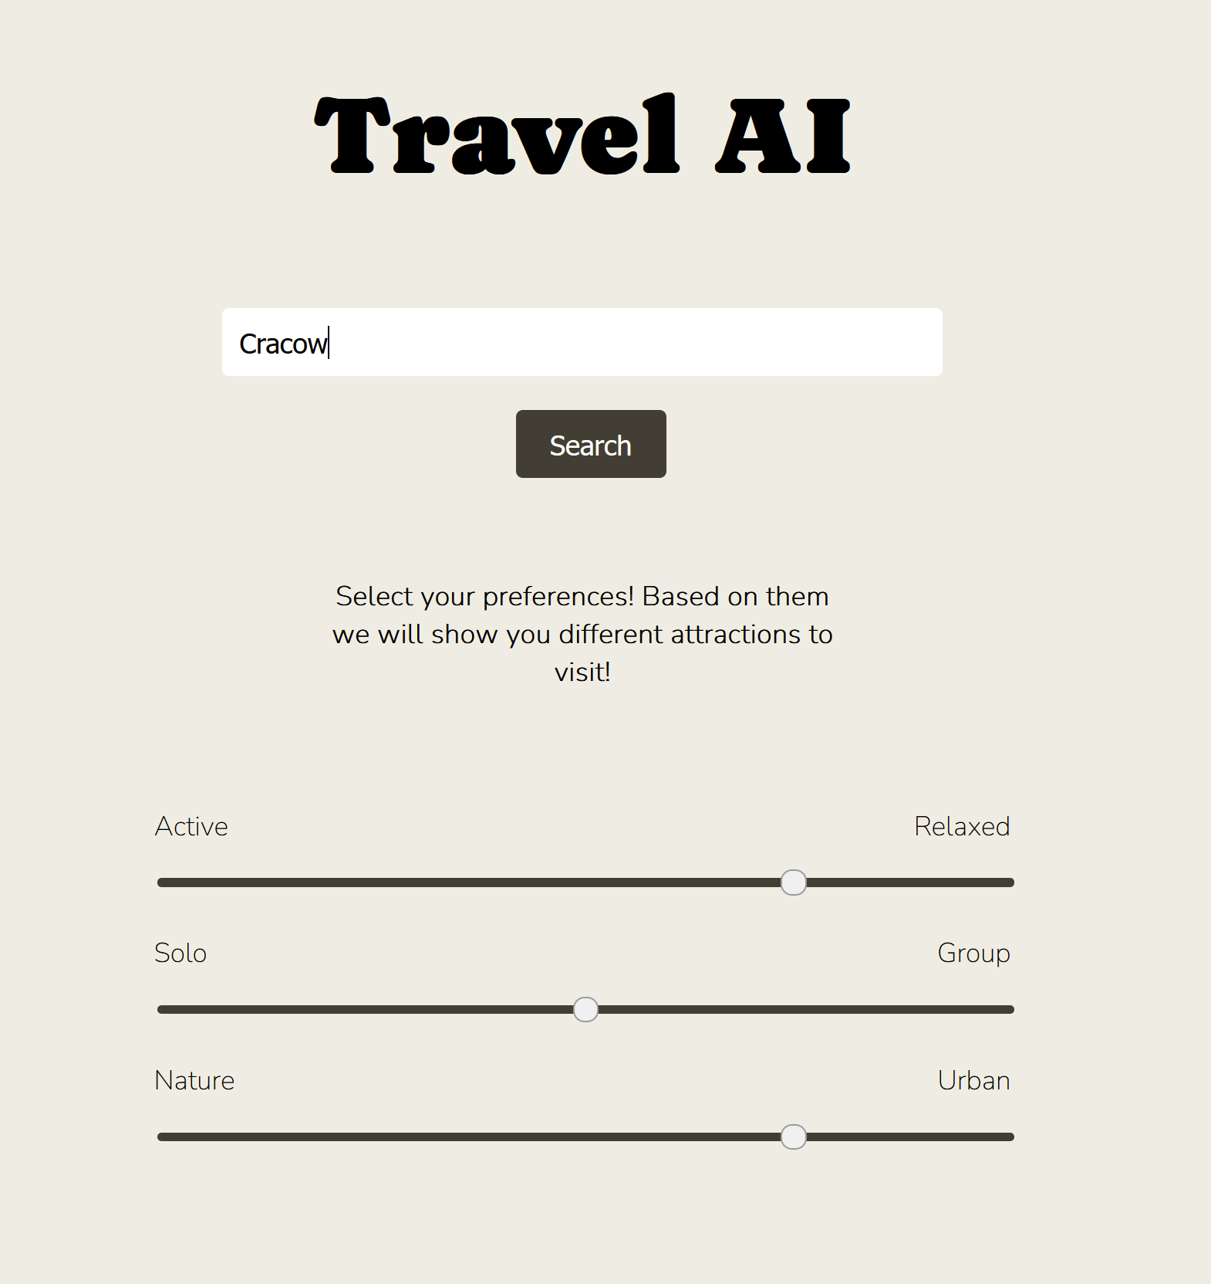

Slide 6
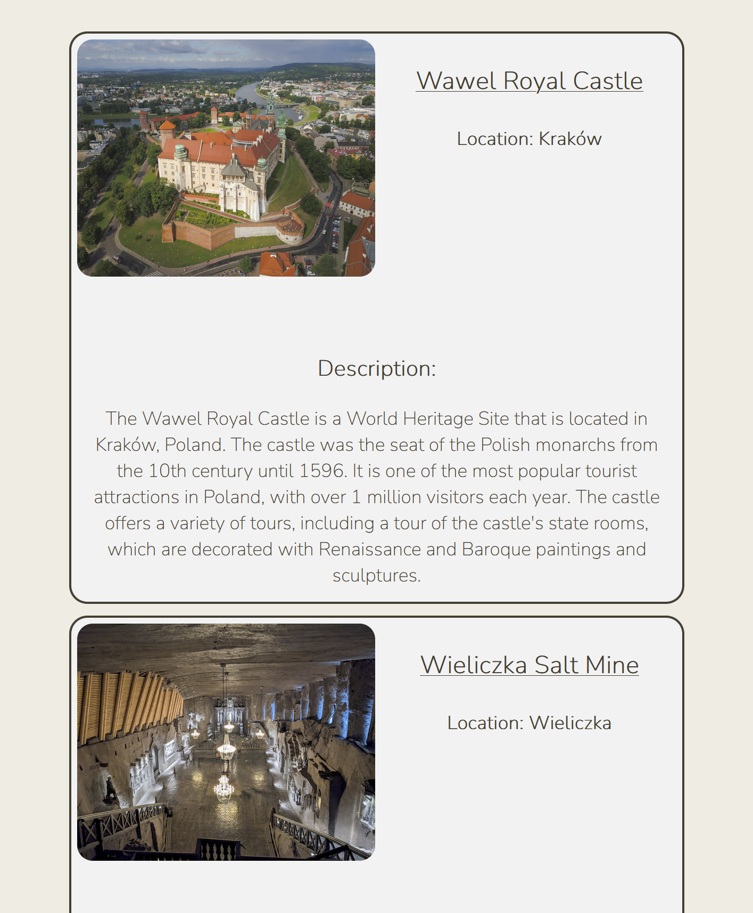
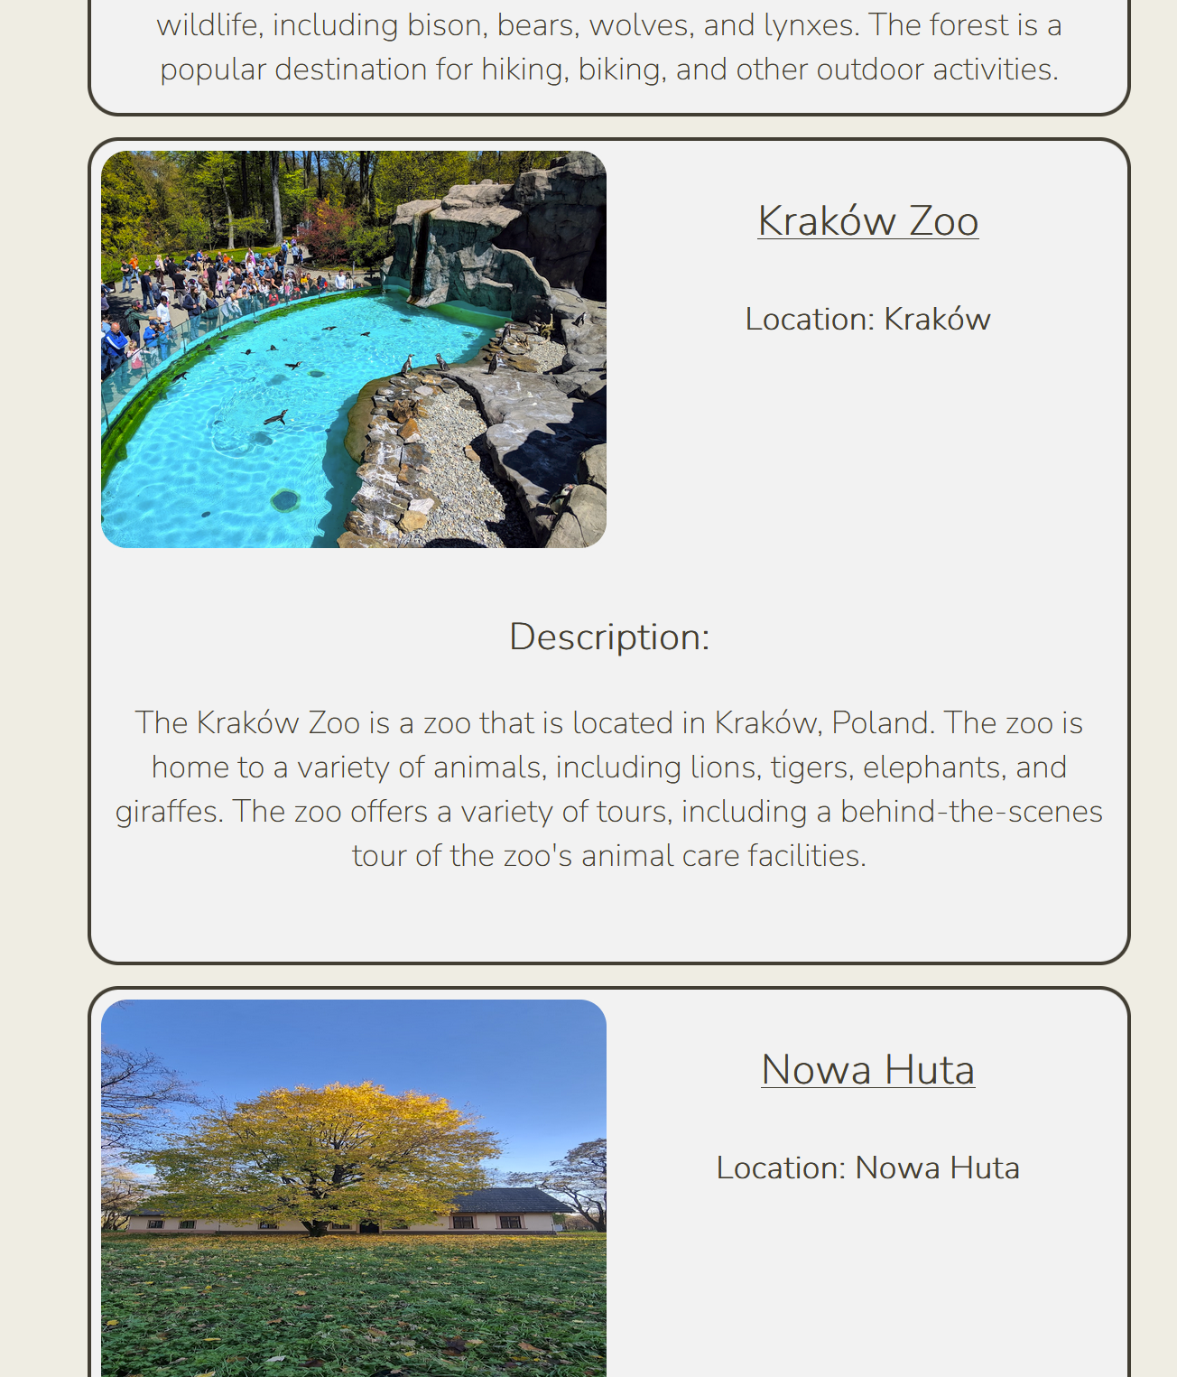

Slide 7





Business perspective
Growing interest among users in the quality, simplicity, and personalized nature of recommended attractions will lead to collaborations with service providers seeking to expand their reach and visibility in the tourism industry.
Increasing user base and the rating system for proposed attractions will allow for the continuous development of the product, incorporating a more accurate model for generating preferred tours. This growth will be fueled by new users and an information collection system that gathers preferences specific to the tourism industry.
The acquired information will enable us to gain deeper insights into the tourism market, thereby attracting entrepreneurs eager to grow their businesses based on our insights and the expanding user base.

Slide 8
Future developments
User Account Registration: Allow users to create an account to store and access their previously generated tours, enabling easy itinerary revision based on preferences and feedback.
Feedback Integration: Implement a system for users to provide input and reviews on attractions and tours, leveraging valuable feedback to continuously improve recommendations for more tailored and accurate tours.
Accommodation Booking Integration: Partner with accommodation providers for seamless in-app booking, offering users a convenient platform to plan and secure lodging alongside tour planning.
Google Maps Integration: Develop a route display within Google Maps, providing detailed directions and real-time updates for smooth navigation between attractions, eliminating the need for multiple apps.
Tour Sharing Option: Enable users to share their customized tours with others, fostering collaboration and inspiration through social sharing of curated itineraries.
Enhanced Transportation Information: Provide comprehensive transportation details tailored to each tour, including public transportation, private car services, and relevant modes of travel, ensuring seamless travel between attractions.
Marketing Campaign and Paid Plans: Launch a targeted marketing campaign for service providers in the tourism industry, fostering collaborations and offering paid plans with added features and benefits to enhance their visibility within the Travel AI platform.

Slide 9

Thank you
Team: https://lablab.ai/event/google-vertex-ai-hackathon/tomekmichal

